Slide 1

基于Microsoft Teams 构建应用集成和工作流 陈 希章 | 微软（亚洲）互联网工程院
实施 Microsoft 身份（一）
实施 Microsoft 身份（二）
Microsoft Graph 简介
扩展 Microsoft SharePoint
扩展 Microsoft Teams (一）
扩展 Microsoft Teams (二）

Slide 2
扩展 Microsoft Teams – 第 2 部分（共 2 部分）
Webhook
Microsoft Graph 团队合作端点
身份验证和 SSO
Teams 和 Power Platform

Slide 3
使用 Webhook 和连接器将 Web 服务连接到 Microsoft Teams
创建传出 Webhook
创建传入 Webhook
Notes:
Webhooks and connectors are a simple way to connect your web services to channels and teams inside Microsoft Teams.
In this section, you’ll learn about webhooks and connectors and how to implement them in Microsoft Teams channels.

Slide 4

用 Webhook 将 Web 服务连接到 Microsoft Teams

Slide 5
Microsoft Teams 中的 Webhook 和连接器
传出和传入 Webhook 均允许开发人员将 Web 服务连接到 Microsoft Teams 中的通道和团队
两种类型：
传出 Webhook 允许用户从一个渠道向开发人员的 Web 服务发送文本信息，而无需使用 Microsoft Bot Framework
传入 Webhook 充当一种连接器，允许用户订阅接收来自开发人员 Web 服务的通知和消息。

Slide 6
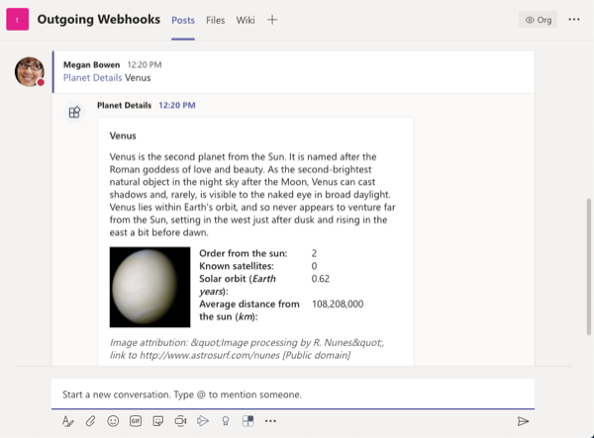
使用传出 Webhook 处理通道消息
传出 Webhook 允许用户将消息从通道发送到你的 Web 服务。
以每个团队为单位进行配置
配置完成后，你的用户可以 @提及你的传出 Webhook，让 Microsoft Teams 将消息发送到你的服务。
Web 服务可以使用基于文本的消息或卡片进行响应
Notes:
An outgoing webhook allows your users to send messages from a channel to your web service. Once configured, your users can @mention your outgoing webhook to have Microsoft Teams send the message to your service.
Your service has five seconds to respond to the message and optionally include a text-based message or a card.
Outgoing webhooks are manually configured on a per-team basis; they aren't included in custom Microsoft Teams apps.

Slide 7
Microsoft Teams 中的传出 Webhook
传出 Webhook 将数据从 Teams 发布到任何能够接受 JSON 有效载荷的选定服务。 将传出 Webhook 添加到团队后，它的作用类似于机器人，使用 @提及在通道中侦听消息，向外部 Web 服务发送通知，并使用包含卡片和图像的富消息进行响应。
主要功能：
范围内的配置
被动消息传递
标准 HTTP 消息交换
Teams API 方法支持
限制
Notes:
Users interact with outgoing webhooks in a similar way as they do with bots. Like a bot, users send a message to an outgoing webhook by @mentioning it. Also like bots, outgoing webhooks can respond to messages sent from Microsoft Teams channels with rich messages that can include cards and images.
However, unlike bots, outgoing webhooks are simpler to set up as they don't require registering and configuring the bot via the Microsoft Bot Framework.
Key features:
Scoped Configuration: Webhooks are scoped at the team level. You’ll need to go through the setup process for each team you want to add your outgoing webhook to.
Reactive Messaging: Users must use @mention for the webhook to receive messages.
Standard HTTP message exchange: Responses will appear in the same chain as the original request message and can include any Bot Framework message content (rich text, images, cards, and emojis).
Microsoft Teams API method support: Outgoing webhooks send an HTTP POST to a web service and process the web service's response. They can't access any other APIs like retrieve the roster or list of channels in a team.
Outgoing webhooks are scoped to the entire team and are visible to all members of the team. Like a bot, users are required to @mention the name of the outgoing webhook to invoke it in a channel.
Limitations:
Outgoing webhooks do not have access to non-messaging APIs, such as team roster membership.
Outgoing webhooks cannot post into channels proactively.
Although outgoing webhooks can use cards, they cannot use button actions such as `imBack` or `invoke`.

Slide 8
添加传出 Webhook
注册传出 Webhook
身份验证消息
回应成功或失败
Notes:
You configure outgoing webhooks on a per-team basis. NOTE: A Teams app used in multiple Teams would require configuring a unique outgoing webhook for each Team.
Register: From a team, add an app by selecting the **Create outgoing webhook** link on the channel's installed apps page
Microsoft Teams will display a security token after you register the outgoing webhook that your web service will use to validate messages it receives are sent from Microsoft Teams
Authenticate: Messages sent from Microsoft Teams to outgoing webhooks include a hash-based message authentication code (HMAC) in the HTTP request's authorization header. Your web service should use the body of the message to generate the HMAC token using the provided security key unique to your outgoing webhook registration.
Respond: The last step in your web service is to respond to the Microsoft Teams request message with a success or failure. Outgoing webhook messages sent from Microsoft Teams are sent synchronously and your web service must respond within five seconds. The response from your web service will be added to the same reply chain as the original message. The reply can be a text string, or a rich message that includes images or a card.

Slide 9
演示
Microsoft Teams 中的 Webhook
创建传出 Webhook
Notes:
See the file M01_Manage roles and create teams.docx for instructions for this demonstration.​
​Demonstrations references in this deck utilize a Microsoft 365 E5 tenant and access to Microsoft Teams.
Set up instructions -Set up can take up to 60min
https://microsoft.sharepoint.com/:w:/t/FY20BaselineLocalEventsPlanning/ERs4HL_d3RNFiwERCPC3mGMBkKo0lIjdgJb_r78bpJYWyg?e=wIQtUi
​

Slide 10
创建传入 Webhook

Slide 11
Microsoft Teams 中的传入 Webhook
传入 Webhook 充当连接器，为外部应用提供在团队通道中共享内容的简单方法。 它们对跟踪和通知很有帮助。
对于你要发布的消息（通常为卡片格式），Teams 可提供唯一 URL，你可以向该 URL 发送 JSON 负载。
主要功能：
范围内的配置
保护资源定义
可操作的消息传递支持
独立的 HTTPS 消息传递支持
Markdown 支持
Notes:
Note: If you include a card in a message sent to an incoming webhook, it must be an Office 365 Connector card; adaptive cards aren't supported when sending messages to incoming webhooks.
Key Features:
Scoped Configuration: Incoming webhooks are scoped and configured at the channel level, unlike outgoing webhooks that are scoped and configured at the team level.
Secure resource definitions: Messages are formatted as JSON payloads. This declarative messaging structure prevents the injection of malicious code as there's no code execution on the client.
Actionable messaging support: If you choose to send messages via cards, you must use the actionable message card format. Actionable message cards are supported in all Microsoft 365 groups including Microsoft Teams.
Independent HTTPS messaging support: Cards are a great way to present information in a clear and consistent way. Any tool or framework that can send HTTPS POST requests can send messages to Microsoft Teams via an incoming webhook.
Markdown support: All text fields in actionable messaging cards support basic Markdown. Don't use HTML markup in your cards. HTML is ignored and treated as plain text.

Slide 12
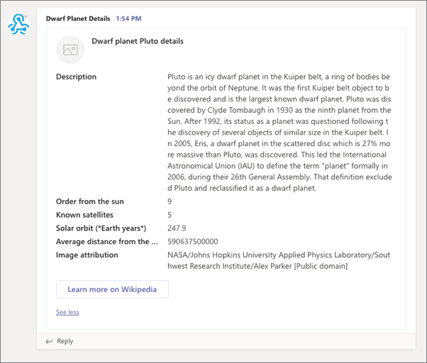
添加传入 Webhook
注册传入 Webhook
从传入 Webhook 向通道发送消息
Notes:
The first step is to create a web service or application that can send HTTP POST requests that include a JSON payload to an HTTPS endpoint.
Register the webhook:
Your incoming webhook will submit its HTTP POST request to a unique endpoint provided by Microsoft Teams. The endpoint is generated when you register the incoming webhook to a channel. After registering the incoming webhook, a dialog will display the unique endpoint your web service will submit HTTP POST requests to. You will update the web service to submit its request to this endpoint.
Send messages to the channel:
When the incoming webhook sends a message to the registered endpoint, Microsoft Teams will add it to the Conversations tab in the configured channel.
NOTE: If you include a card in a message sent to an incoming webhook, it must be an Office 365 Connector Cards; adaptive cards aren't supported when sending messages to incoming webhooks.

Slide 13
使用团队合作的 Microsoft Graph 端点
使用 Microsoft Graph 与 Microsoft Teams
用 Microsoft Graph 配置内置选项卡
使用 Microsoft Graph 发布到活动源
Notes:
Developers can tap into the power of Microsoft Teams with Microsoft Graph to integrate your custom applications. In this section, you'll learn how to use Microsoft Graph to interact with Microsoft Teams.

Slide 14
使用 Microsoft Graph 与 Microsoft Teams

Slide 15
为什么要与 Microsoft Teams 整合？
实现团队生命周期自动化
即使周围没有人，也能完成工作
创建与你的应用关联的团队
将应用部署到团队
在任何类型的应用中使用 Microsoft Graph
获取有关更改的通知
Notes:
There are many benefits to using the teamwork endpoint in Microsoft Graph to interact with Microsoft Teams.
Automate team lifecycles
Use Microsoft Graph to create a new virtual team when a new business issue arises, add the right people to the team, and configure the team with channels, tabs, and apps. If you want to get the new team together to discuss the business issue, add a new event to the team calendar.
When the business issue is resolved and you no longer need the team, use the Microsoft Teams API to archive or delete the team. If you know the maximum duration of the team when you create it, set a Microsoft 365 group expiration policy for the team that automatically removes the team according to the policy.
Get work done even when no one is around
Use application permissions to work with teams, channels, and tabs without human intervention. Create a new channel when your customer files an order. Automatically create teams for classes at the beginning of the school year, and archive them at the end.
Create teams linked to your app
Let customers create new teams and channels. Install your Teams app in the new teams. Pin your app to a tab in the new channel. Send messages to the channel linking back to your website.
Create and manage multiple teams and channels
Microsoft Graph makes it easy to create large numbers of teams and populate them with users and channels, by automate creating and managing teams, channels, tabs, and apps. Microsoft Graph also lets you find and archive the teams you're no longer using. This is the same API that the Microsoft Teams Admin Center and Teams PowerShell cmdlets are built on.
Deploy apps to teams
List the teams in your tenant, and install apps to them. Create tabs in channels to give users easy access to apps.
Use Microsoft Graph in any kind of app
Microsoft Teams apps give work groups a new tool to make collaboration a more productive and compelling experience. These apps let work group users share assets, interact through chat, and schedule events on the team calendar. These apps can also automate creating teams, channels, and conversations, enhancing the value of Microsoft Teams.
You can create web sites, services, and native platform applications that run outside the Microsoft Teams user experience, and call the Teams API to automate Teams scenarios.
These collaboration tools include Microsoft Graph-enabled tabs or bots running inside Microsoft Teams apps. You can also call Microsoft Graph outside of a Microsoft Teams app, such as from a website or a web service. If you've already enabled your website for Microsoft Graph, you can use that work for Microsoft Teams by using the Microsoft Teams developer platform to create a tab that uses the existing website code.
Get notified about changes
Microsoft Teams supports subscribing to changes (create, update, and delete) to messages in channels and chats to allow apps to get near-instant updates.

Slide 16
Microsoft Graph 和团队合作端点
Microsoft Teams 团队建立在 Microsoft 365 组和 SharePoint 网站上
许多 API 调用将使用 /groups 端点
Microsoft Graph 的团队合作端点：/team

Slide 17
创建团队 (1)：创建 Microsoft 365 组
使用 Microsoft 创建组
图形 v1.0`/ groups` 端点
提交 HTTP POST
与该组的详细信息
POST https://graph.microsoft.com/v1.0/groups
{
"displayName":"Flight 157", "mailNickname":"flight157",
"description":"Everything about flight 157",
"visibility":"Private",
"groupTypes":["Unified"],
"mailEnabled":true, "securityEnabled":false,
"members@odata.bind":[
"https://graph.microsoft.com/v1.0/users/bec05f3d-a818-4b58-8c2e-2b4e74b0246d",
"https://graph.microsoft.com/v1.0/users/ae67a4f4-2308-4522-9021-9f402ff0fba8"
],
"owners@odata.bind":[
"https://graph.microsoft.com/v1.0/users/6a1272b5-f6fc-45c4-95fe-fe7c5a676133"
]
}
Notes:
All teams are backed by Microsoft 365 groups. The quickest way to get your team up and running when you create new teams with Microsoft Graph is to set up a new Microsoft 365 group, all owners and members, and convert that into a team.
When creating a new group that will be converted to a team, you must do the following:
set groupTypes = Unified
set mailEnabled = true
set securityEnabled = false
Create the group using the Microsoft Graph v1 /groups endpoint by submitting an HTTP POST with the group's details

Slide 18
创建团队 (2)：转换组
创建 Microsoft 365 组后，你可以将其转换为具有/ teams` 端点的 Microsoft Teams 团队。
提交包括 Microsoft 365 组 ID 的
HTTP POST 以转换为团队。
POST https://graph.microsoft.com/v1.0/groups
{
"displayName":"Flight 157", "mailNickname":"flight157",
"description":"Everything about flight 157",
"visibility":"Private",
"groupTypes":["Unified"],
"mailEnabled":true, "securityEnabled":false,
"members@odata.bind":[
"https://graph.microsoft.com/v1.0/users/bec05f3d-a818-4b58-8c2e-2b4e74b0246d",
"https://graph.microsoft.com/v1.0/users/ae67a4f4-2308-4522-9021-9f402ff0fba8"
],
"owners@odata.bind":[
"https://graph.microsoft.com/v1.0/users/6a1272b5-f6fc-45c4-95fe-fe7c5a676133"
]
}

Slide 19
列出团队
列出所有团队：
https://graph.microsoft.com/v1.0/groups?$select=id,resourceProvisioningOptions
获取特定团队：
https://graph.microsoft.com/v1.0/teams/{group-id}
列出当前用户加入的所有团队：
https://graph.microsoft.com/v1.0/me/joinedTeams
Notes:
To list all teams in an organization (tenant), you find all groups that have teams, and then get information for each team.
Start by submitting a request for a list of all groups. To get a list of all groups in the organization that have teams, get a list of all groups and then in code find the ones that have a `resourceProvisioningOptions` property that contains **Team**.
Groups are large objects, so you may want to use the `$select` query parameter to only get the properties of the group you care about
To get details on a specific team, use the `/groups` endpoint and specify the group by it's ID
Tip: When working with the Microsoft Teams support in Microsoft Graph, keep in mind a team has two types of IDs. The `groupID` for a team is in the format of a GUID while the `teamID` can be in the format of `19:[id]@thread.skype`.

Slide 20
Microsoft Teams 中的受保护 API
Microsoft Graph 公开的一些 Microsoft Teams API 可以访问敏感数据
这些 API 被视为受保护的 API
除了在 Azure AD 中定义和同意的权限之外，还需要额外的验证。
应用开发人员必须提交申请才能使用受保护的 API
Notes:
Learn more: https://docs.microsoft.com/graph/teams-protected-apis

Slide 21
演示
Microsoft Graph 团队合作端点
团队合作端点简介
Notes:
See the file M01_Manage roles and create teams.docx for instructions for this demonstration.​
​Demonstrations references in this deck utilize a Microsoft 365 E5 tenant and access to Microsoft Teams.
Set up instructions -Set up can take up to 60min
https://microsoft.sharepoint.com/:w:/t/FY20BaselineLocalEventsPlanning/ERs4HL_d3RNFiwERCPC3mGMBkKo0lIjdgJb_r78bpJYWyg?e=wIQtUi
​

Slide 22
用 Microsoft Graph 配置内置选项卡

Slide 23
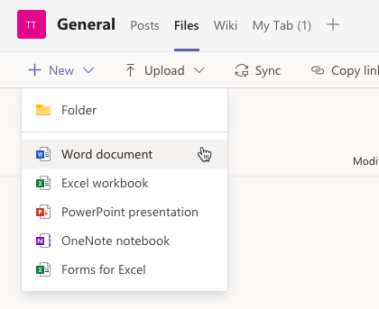
Microsoft Teams 内置通道选项卡
Microsoft Teams 包括多个内置通道 选项卡
使用这些选项卡为通道成员显示富内容
许多标签是可配置的，以指定它们应显示的 内容。
一些支持包括网站的 URL，以跳出 Microsoft Teams 并进入浏览器
Notes:
Built-in Microsoft Teams tabs for websites, Office documents, SharePoint document libraries, and other tabs can be configured using Microsoft Graph. You can use these tabs to display rich content to your channel members by adding the tabs programmatically using the Microsoft Graph teamwork endpoint.
Microsoft Teams supports the following built-in tabs:
Website tabs
Office clients (Word, Excel, PowerPoint, OneNote) tabs
PDF tabs
SharePoint (document libraries & pages) tabs
Planner tabs
Microsoft Stream tabs
Microsoft Forms tabs
Power BI tabs

Slide 24
使用 Microsoft Graph 的团队合作端点来创建和更新选项卡
创建和管理包含团队合作端点的 Microsoft Teams 选项卡
需要了解应用的 teamsAppId，以及 entityId、contentUrl、removeUrl 和 websiteUrl 以提供此类应用。
要创建或配置一个选项卡，就要将 HTTP POST 提交到 /选项卡端点，该端点位于一个通道中，其中的有效负载包含用于配置此选项卡的设置。
使用端点
使用 HTTP GET 获取选项卡
使用 HTTP POST 创建选项卡
在创建或更新标签时包括一个配置对象
Notes:
The teamsAppId is also the id property in the app's manifest.

Slide 25
Microsoft Graph 的选项卡端点
HTTP
HTTP POST https://graph.microsoft.com/v1.0/teams/{groupId}/channels/{channelId}/tabs
Content-Type: application/json
{
"displayName": "Word",
"teamsApp@odata.bind" : "https://graph.microsoft.com/v1.0/appCatalogs/teamsApps/{teamsAppId}",
"configuration": {
"entityId": "CA2E9D19-3FE7-4E60-82DF-F73BD3B8D302",
"contentUrl": "https://{tenant}.sharepoint.com/sites/TestTeam/Shared Documents/General/sample.docx",
"removeUrl": null,
"websiteUrl": null
}
}
Notes:
To create or configure a tab, submit an HTTP POST to the /tabs endpoint on a channel with a payload that contains the settings to configure the tab:
HTTP
Some properties are required (contentUrl) for most tabs, some are rarely required (removeUrl) depending on the tab you're creating
contentUrl: content to display in the tab
websiteUrl: page to direct the user to when the tab can’t be shown (certain clients)
removeUrl: page to display in a dialog when tab is deleted from the channel
entityId: sometimes used to reference a specific item (Word, Excel, PowerPoint, etc)
In the sample code listing is an example Microsoft Word tab that loads the **sample.docx** document from a SharePoint document library, the `{groupId}` and `{channelId}` should be replaced with the ID values of the team and channel the tab will be created/updated in.
The `{teamsAppId}` is the ID of the application as defined in it's manifest.
The `teamsApp@odata.bind` property is what defines the Microsoft Teams app the tab is defined in.
The `configuration` object contains multiple properties, some that are required, that the tab uses to load the specified content.

Slide 26
内置选项卡和应用 ID
Microsoft Teams 内置应用有众所周知的 ID，可用于其可配置选项卡
选项卡 ID 在已安装应用清单中定义
在配置选项卡时，teamsApp@odata.bind 属性告知 Microsoft Teams 要加载哪个选项卡
应用 ID 是字符串或者 GUID，具体取决于应用
"teamsApp@odata.bind" :"https://graph.microsoft.com/
v1.0/appCatalogs/teamsApps/{teamsAppId}"

Slide 27
选项卡应用 ID
选项卡应用 | teamsAppId
Word | com.microsoft.teamspace.tab.file.staticviewer.word
Excel | com.microsoft.teamspace.tab.file.staticviewer.excel
PowerPoint | com.microsoft.teamspace.tab.file.staticviewer.powerpoint
PDF | com.microsoft.teamspace.tab.file.staticviewer.pdf
网站 | com.microsoft.teamspace.tab.web
SharePoint 文档 | com.microsoft.teamspace.tab.files.sharepoint
SharePoint 列表 / 页面 | 2a527703-1f6f-4559-a332-d8a7d288cd88
Microsoft Stream | com.microsoftstream.embed.skypeteamstab
Microsoft Forms | 81fef3a6-72aa-4648-a763-de824aeafb7d
OneNote | 0d820ecd-def2-4297-adad-78056cde7c78
Planner | com.microsoft.teamspace.tab.planner
Power BI | com.microsoft.teamspace.tab.powerbi

Slide 28
选项卡配置属性
应用 | entityId | contentUrl | websiteUrl | removeUrl
Word、Excel、PowerPoint、PDF | 源文档 ID | 指向底层 SharePoint 文档库中文件的 URL | null | null
网站 | URL | URL | null | null
SharePoint 文档 | “” | 指向底层 SharePoint 文档库的 URL | null | null
SharePoint 列表 / 页面 | null | null | null | null
Microsoft Stream | null | null | null | null
Microsoft Forms | null | null | null | null
OneNote | null | null | null | null
Planner | null | null | null | null
Power BI | null | null | null | null
Notes:
Website tabs
For website tabs, the teamsAppId should be set to com.microsoft.teamspace.tab.web.
Then, set the contentUrl and websiteUrl properties to the URL of the page to load in the tab. The other two properties, entityId and removeUrl should be set to null.
Word, Excel, PowerPoint, and PDF tabs
For website tabs, the teamsAppId should be set depending on the file type
The contentUrl property should be set to the URL of the document in the SharePoint library in the site that supports the current team. This should be in the format {folder-webUrl}/{filename}
The entityId property should be set to the document's ID in the SharePoint library. This is displayed in the URL parameter sourcedoc when viewing a file in a SharePoint library.
The other two properties, websiteUrl and removeUrl should be set to null.
SharePoint document library, list, and page tabs
When creating a tab to show content within a SharePoint site, such as a document library, list, or page, the configuration options are simpler than the other tabs covered.
First, the teamsAppId should be set depending on the tab:
The list & page types don't support configuration, so you can omit the configuration element from the request.
However, for a document library, the entityId should be set to an empty string. The contentUrl should be set to the URL of the root folder of the document library, while the websiteUrl and removeUrl properties should be set to null.
All other tabs
The remaining built-in tabs don't support configuration so you only need to set the teamsAppId value when setting them

Slide 29
使用 Microsoft Graph 发布到活动源

Slide 30
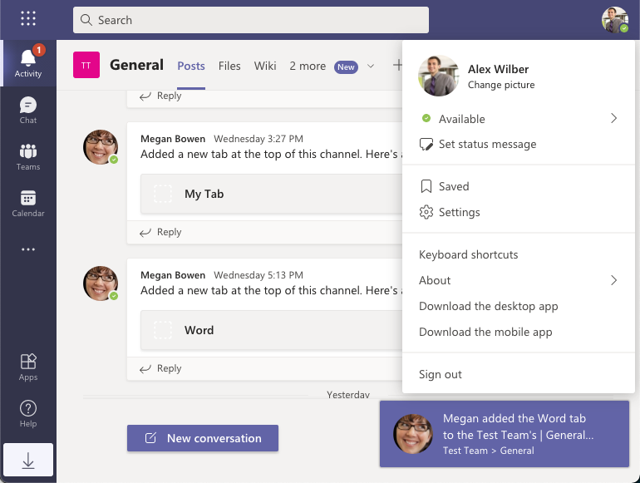
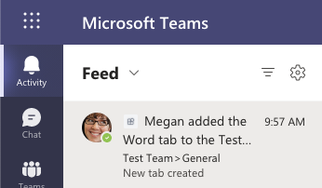
活动源通知
使应用能够通知用户查看特定于他们的相关项目
Notes:
The Microsoft Teams activity feed enables users to see a list of relevant items specific to them. Users can use the activity feed to address changes, notifications, and other alerts in a productive manner.

Slide 31
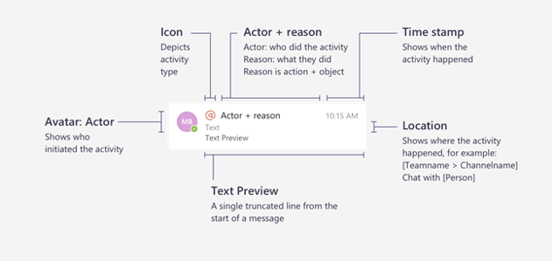
活动源通知剖析
Notes:
Activity feed notifications in Microsoft Teams are composed of multiple bits of information, displayed together, as shown in the following image.
The notification object contains the following components, as shown in the image above:
- The actor who started the activity
- An icon that represents the activity type
- The reason the actor did the activity
- A text preview
- A time stamp
- The location of the activity
The activity feed notifications are used to inform a user of something. Microsoft Teams apps can be installed for users, teams, and group chats that mean there are three different contexts that your app can send a notification to a user:
- notify a user
- notify a user in a team
- notify a user in chat

Slide 32
发送活动源通知的要求
必须为通知的接收者安装自定义 Microsoft Teams 应用
1
自定义 Microsoft Teams 应用必须与 Azure AD 应用注册相关联
2
通知活动类型必须在自定义 Microsoft Teams 应用的清单中注册
3
Notes:
To send a notification to a user from your custom Microsoft Teams app, you must meet the following requirements:
For a user to receive the notification, the custom Microsoft Teams app must be installed for the recipient of the notification. This can be done by the recipient (such as a Personal app), or in a team or group chat they're associated with.
- The custom Microsoft Teams app must be associated with an Azure Active Directory (Azure AD) application.
- Notification activity types supported by your application must be defined in the application's manifest.

Slide 33
要求 #2：将 Microsoft Teams 应用与 Azure AD 应用关联起来
第一个要求是将 Microsoft Teams 应用与为该应用创建的 Azure AD 应用注册关联起来。
JSON
{ "$schema": "https://developer.microsoft.com/en-us/json-schemas/teams/v1.8/MicrosoftTeams.schema.json", "manifestVersion": "1.8", ... "webApplicationInfo": { "id": "8a2d385d-8504-43f8-a9b2-80caa44bfe22", "resource": "api://app.contoso.com/8a2d385d-8504-43f8-a9b2-80caa44bfe22" } }
Notes:
Let’s look at the 2nd requirement: the second requirement is to associate the Microsoft Teams app with the Azure AD app registration created for the app.
The Azure AD app is used to define permissions and ensure the app (and user) has gone through the consent process before sending notifications.
This association is defined in the Microsoft Teams app manifest file (see slide)
> [!IMPORTANT]
> Activity feed notifications are supported in the Microsoft Teams app manifest schema v1.7 or higher.
The `id` property should be set to the Azure AD app's client ID, while the `resource` should be set to the Azure AD app's URI.

Slide 34
要求 #3：注册支持的活动类型
第三个要求是使用 Microsoft Teams 注册应用可以发送相关通知的活动的类型。
JSON
{ "$schema": "https://developer.microsoft.com/en-us/json-schemas/teams/v1.8/MicrosoftTeams.schema.json", "manifestVersion": "1.8", ... "activities": { "activityTypes": [ { "type": "userMention", "description": "Personal Mention Activity", "templateText": "{actor} added the {tabName} tab to the {teamName}'s | {channelName} channel" } ] } }
Notes:
The third requirement is to register with Microsoft Teams the types of activities the app can send notifications about.
The activity registration, like the Azure AD app association, is done in the Microsoft Teams app's manifest file (see slide)
Each activity has a `type` property that must be unique in the app's manifest. This is how your API will send consistent notifications to your users. The `templateText` property contains the string that's used to display the alert message. You'll notice this is a parameterized string where your app can define the parameters. Parameters are indicated with the `{` and `}` characters.
> [!NOTE]
> A special parameter, `{actor}`, is always inserted by Microsoft Teams. It represents the name of the caller which is either the user or app that sent the activity feed notification.

Slide 35
发送活动源通知
活动源通知通过使用 HTTP POST 的 Microsoft Graph 的 /teams/{groupId}/sendActivityNotification 端点发送给用户。
JSON
{ "topic": { "source": "entityUrl", "value": "https://graph.microsoft.com/v1.0/teams/{groupId}" }, "activityType": "userMention", "previewText": { "content": "New tab created" }, "recipient": { "@odata.type": "microsoft.graph.aadUserNotificationRecipient", "userId": "{recipient-objectID}" }, "templateParameters": [ { "name": "tabName", "value": "Word" }, { "name": "teamName", "value": "Test Team" }, { "name": "channelName", "value": "General" } ] }
Notes:
Activity feed notifications are sent to users with the Microsoft Graph's `/teams/{groupId}/sendActivityNotification` beta endpoint using an HTTP POST.
The body of the http request contains the details of the notification.
The `topic` object represents the subject of the notification - it specifies the resource being talked about in the notification. This can be either `entityUrl` or `text`.
Learn more about the `topic` type: [Microsoft Graph: teamworkActivityTopic resource type](/graph/api/resources/teamworkactivitytopic).
The `activity` property must match one of the activities listed in the Microsoft Teams app's manifest file.
The `previewText` contains the text for the notification. Only the first 150 characters are shown in Microsoft Teams.
The `recipient` contains a reference to the intended recipient of the notification message.
The `templateParameters` is an array of name-value pairs that Microsoft Teams will use to replace parameterized values in the activity as defined in the Microsoft Teams app manifest file.

Slide 36
Microsoft Teams 上的身份验证和单点登录
了解 Microsoft Teams 应用中的身份验证和单点登录
使用 Microsoft Teams 选项卡的单点登录 (SSO)
使用 Microsoft Teams 机器人的单点登录 (SSO)
Notes:
Developers can create Microsoft Teams apps to create new experiences for their users and integrate with existing business solutions. When custom applications need to access user information protected by Azure AD, and data from other services, apps will need to establish a trusted connection with these providers. In this section, you'll learn about the different authentication flows supported by Microsoft Teams that you can use in your custom apps.

Slide 37
了解 Microsoft Teams 应用中的身份验证和单点登录

Slide 38
Microsoft Teams 和单点登录 (SSO)
针对选项卡、任务模块和机器人的 Microsoft Teams SSO 支持
减少提示用户登录第三方服务的频率
Teams 应用的 SSO 要求：
注册 Azure AD 应用
将 Microsoft Teams 应用与 Azure AD 应用关联
在选项卡或机器人中实现代码，以便从 Microsoft Teams 获取访问令牌
Notes:
Microsoft added support for SSO to Microsoft Teams in 2020. This capability reduces how often a user is prompted to log in to third-party services.
Microsoft Teams SSO support is implemented in combination with code in your custom app and Azure AD.
To support SSO, a Microsoft Teams app must have a corresponding Azure AD application registration. This app registration defines what permissions the app supports and trusts the Microsoft Teams client applications to act on behalf of the user.
Using this support for SSO, apps can request the user's profile information or information from Microsoft Graph.
Users can consent Microsoft Teams apps for themselves to allow the app to obtain their profile information. The app can then use this profile information provided by Azure AD and Microsoft Teams as the ID of the currently signed in user.
Administrators can consent for an entire organization via a centralized deployment process so each user doesn't have to individually go through the consent process.
Microsoft Teams SSO supports both types of accounts supported by Microsoft: Work and School accounts (Azure AD accounts) and Microsoft accounts (MSA).
Implementing SSO:
Microsoft Teams SSO is supported in both custom tabs and bots. The implementation and specifics of how it works differs between the two because tabs are rooted in a web experience with user interaction while bots are entirely service driven. Each of these two types of customizations that support SSO share common characteristics, specifically with the Azure AD application used to identify the user.
For a Microsoft Teams app to support SSO, you must do the following things:
Register an Azure AD application
Associate a Microsoft Teams app with the Azure AD application
Implement the code in the tab or bot to obtain an access token from Microsoft Teams

Slide 39
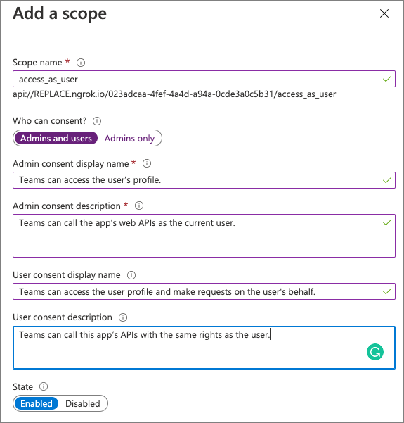
注册 Azure AD 应用
使用客户端 ID 和客户端证书或密钥对 Azure AD 进行身份验证。
指定一个重定向 URL
必须是多租户应用
公开 access_as_user 权限
信任所有 Microsoft Teams 客户端 应用
Notes:
The first step to enable SSO is to register an Azure AD application for the app.
The developer tools provided by Microsoft include a process that will register the Azure AD application with all the required settings during your development process.
Like most Azure AD applications, your app will need to authenticate with Azure AD using a client ID and either a client certificate or secret.
You'll also need to specify the Redirect URL where Azure AD should send the access token upon a successful authentication. The value for this URL will differ depending if you're creating a tab or bot.
Azure AD applications used to support SSO in Microsoft Teams have many requirements. For example, they must be multitenant applications, they expose the access_as_user permission, and should also trust all Microsoft Teams client applications calling the app.
Creating and configuring this permission is done in the Expose an API section of the Azure AD app configuration. Here you specify a unique URI for the application in the format of api://APP_HOST_DOMAIN/APP_ID.
You then add permissions and optionally trust existing client apps to call this permission. When you automatically trust existing client apps, such as Microsoft Teams desktop, mobile, and web clients, Azure AD won't require the user to consent the application this permission.
To configure the Azure AD application to trust the Microsoft Teams clients, add them to the app as preauthorized applications by their ID's and trust the access_as_user permission:
Microsoft Teams mobile & desktop clients: 1fec8e78-bce4-4aaf-ab1b-5451cc387264
Microsoft Teams web client: 5e3ce6c0-2b1f-4285-8d4b-75ee78787346

Slide 40
将 Microsoft Teams 应用与 Azure AD 应用关联
将应用链接到应用清单中的 Azure AD 应用
在 webApplicationInfo 对象中 定义
Id：Azure AD 应用的 [客户端] ID
Resource：Azure AD 应用注册中列出的加载项的 URI
JSON
"webApplicationInfo": { "id": "023adcaa-4fef-4a4d-a94a-0cde3a0c5b31", "resource": "api://app.contoso.com/023adcaa-4fef-4a4d-a94a-0cde3a0c5b31" }
Notes:
Once the Azure AD application has been created, it must be associated with the Microsoft Teams app. This is done in the app's manifest.json file in the webApplicationInfo section.
There are two parts of this section that must be updated for your application:
ID: This is the client ID of the registered Azure AD application
Resource: This is the URL of the app, which is the same thing as the URI that was used when registering the app in Azure AD. The domain portion of the URI must also be listed in the validDomains array in the app's manifest. For bots, the domain should be replaced with botid-

Slide 41
在选项卡或机器人中实现代码以获取访问令牌
此令牌仅用于标识用户：它没有 Microsoft Graph 的权限。
使用访问令牌标识用户
存储用户首选项或特定于当前登录用户的其他信息。
在自己的 API 中使用访问令牌
在转发从 Microsoft Teams 收到的令牌时，实施公认的最佳实践。
使用访问令牌访问 Microsoft Graph
用作“启动”令牌以启动 OAuth2 On-Behalf-Of (OBO) 流。
Notes:
The last step is to write the code that requests an access token from Azure AD for the current user. This token is only used to identify the user: it won't have permissions for Microsoft Graph.
Use the access token to identify the user
Your app may need to identify the user. In this case, your app typically provides this token to your own backend system that uses the token to store user preferences or other information specific to the currently signed in user.
In this scenario, the token returned includes a few properties that can be useful to your application:
name: this is the user's display name
preferred_username: this is the user's UPN, or email address
oid: this is the unique object ID of the user - this should be used to identify the user in your back-end system as the name and preferred_username properties can be changed by the user or an administrator
tid: this is the unique tenant ID the user belongs to
Use the access token in your own API
If you use the access token in your own API, you should implement accepted best practices when forwarding the token received from Microsoft Teams. This includes validating the token to ensure it was created by Azure AD, it's from the expected authority, the app is the intended audience of the token, the token hasn't expired, and the scope is set to access_as_user.
Use the access token to access Microsoft Graph
In the scenario where your app needs to access Microsoft Graph, your code can use this token provided by Microsoft Teams to your app to start the OAuth2 On-Behalf-Of (OBO) flow. When the token is used in this way, it's referred to as the "bootstrap token" because it's only used to obtain an access token that can be used to call Microsoft Graph.
Other units in this lesson will focus on the specifics of each implementation of SSO in tabs and bots.

Slide 42
演示
Microsoft Teams 上的身份验证和单点登录
为 Microsoft Teams 应用实施 SSO
Notes:
See the file M01_Manage roles and create teams.docx for instructions for this demonstration.​
​Demonstrations references in this deck utilize a Microsoft 365 E5 tenant and access to Microsoft Teams.
Set up instructions -Set up can take up to 60min
https://microsoft.sharepoint.com/:w:/t/FY20BaselineLocalEventsPlanning/ERs4HL_d3RNFiwERCPC3mGMBkKo0lIjdgJb_r78bpJYWyg?e=wIQtUi
​

Slide 43
使用 Microsoft Teams 选项卡的单点登录 (SSO)
Notes:
Developers can create custom tabs for Microsoft Teams that display user information using Microsoft Graph. Because users sign in to Microsoft Teams via their Azure Active Directory (Azure AD) accounts in Microsoft 365, developers can take advantage of this by implementing single sign-on (SSO) to authorize the tab.
If a user consents to use your app, they don't have to consent again on another device as they're signed in automatically. Also, your access token is prefetched to improve performance and load times.
Tip: While this unit focuses on implementing SSO for tabs, it also applies to implementing SSO for Microsoft Teams task modules that embed web content as well.

Slide 44
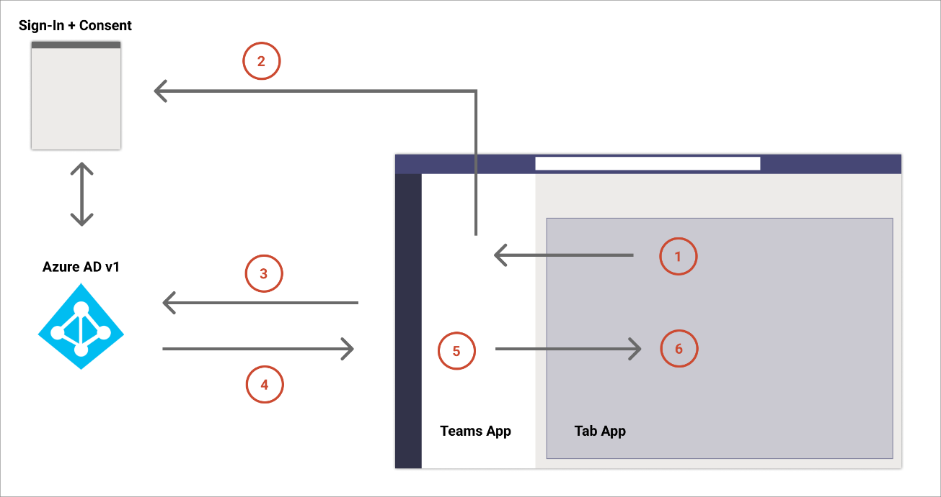
了解选项卡的 SSO 身份验证流
在选项卡中，对 getAuthToken()
进行 JavaScript 调用提示用户同意（如果需要同意），或处理逐步身份验证（例如双因素身份验证）。
Microsoft Teams 从 Azure AD 终结点为当前用户请求选项卡应用令牌。
Azure AD 将选项卡应用令牌发送到 Microsoft Teams 应用。
Microsoft Teams 将选项卡应用令牌发送到选项卡， 以响应 getAuthToken() 调用。
令牌在选项卡应用中使用 JavaScript 进行解析，以提取所需的信息，如用户的电子邮件地址。
* Microsoft Teams 只能提示同意 OpenID 配置文件范围，而不是任何 Microsoft Graph 权限。
Notes:
Important to note: The steps outlined above state that Microsoft Teams can prompt the user to consent the app permissions to sign them in. However, it's worth noting that Microsoft Teams can only prompt for consent for the OpenID profile scope. Microsoft Teams can't prompt the user to consent any of the Microsoft Graph permissions.
This can introduce a challenge with your app because it can't know if this initial bootstrap token can be used in the OAuth2 On-Behalf-Of flow to obtain an access token to call Microsoft Graph.
If your code needs permissions to Microsoft Graph, or more permissions that the user hasn't consented to yet, when Microsoft Graph receives the bootstrap token, it will fail with a specific error code: AADSTS65001. This error code indicates consent to the requested Microsoft Graph permissions hasn't been granted yet.
In this scenario, your app should gracefully handle this scenario with a fallback authorization system that prompts the user to consent the necessary Microsoft Graph permissions.

Slide 45
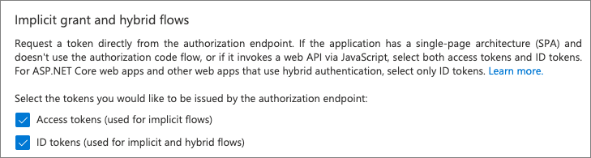
针对 SSO 配置 Azure AD 应用
所有实施 SSO 的 Microsoft Teams 应用也必须注册关联的 Azure AD 应用。
客户端 ID 和客户端证书/密钥：你的应用使用这些来通过 Azure AD 进行身份验证
权限：这是应用需要用户同意的 API 权限的列表，例如 User.Read 或 Mail.Read
获取包含 OAuth2 隐式流的令牌：Microsoft Teams 必须能够获取访问令牌和 ID 令牌
access_as_user 权限：此权限由应用注册公开，用于授予应用（如 Microsoft Teams）代表 用户执行操作的权限：
预授权 Microsoft Teams 客户端代表用户执行操作：此设置消除了用户明确同意允许 Microsoft Teams 代表用户执行操作的要求
Notes:
All Microsoft Teams app that implement SSO must also have an associated Azure AD app registered. The Azure AD app used for tab SSO shares many characteristics when used for bot SSO. For example, all Azure AD apps used with Microsoft Teams SSO must have the following:
client ID & client certificate/secret: these are used by your app to authenticate with Azure AD
permissions: this is a list of the API permissions your app needs the user to consent to, such as User.Read or Mail.Read
obtain tokens with the OAuth2 implicit flow: Microsoft Teams must be able to obtain the access tokens and ID tokens (screenshot #1)
access_as_user permission: this permission exposed by the app registration is used to grant apps, such as Microsoft Teams, to act on the user's behalf (screenshot #2)
preauthorize Microsoft Teams clients to act on the user's behalf: this setting removes the requirement for users to explicitly consenting to allow Microsoft Teams to act on the user's behalf
All of these characteristics of an Azure AD app registration are shared requirements when you use implement SSO for Microsoft Teams tabs and bots.

Slide 46
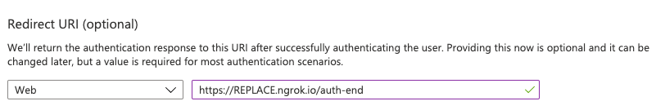
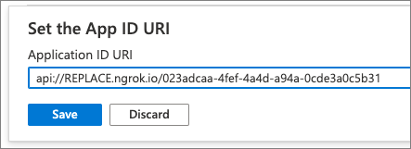
选项卡 Azure AD 应用的独有特征
与机器人的服务器端性质相比，Microsoft Teams 选项卡有一些独特的特点，因为它们是基于 Web 的互动体验。
应用的重定向 URI 应指向托管选项卡实现的 URL。
公开 API 权限 access_as_user 时，应用 ID URI 应 包括托管选项卡实现的域。

Slide 47
将 Azure AD 应用与 Microsoft Teams 应用关联
首先，你必须将 Azure AD 应用与 Microsoft Teams 应用关联。
JSON
"webApplicationInfo": { "id": "023adcaa-4fef-4a4d-a94a-0cde3a0c5b31", "resource": "api://REPLACE.ngrok.io/023adcaa-4fef-4a4d-a94a-0cde3a0c5b31" }
ID：这是注册的 Azure AD 应用的客户 ID
资源：这是应用的 URL，与在 Azure AD 中注册应用时使用的 URI 相同。 URI 的域部分也必须列在应用清单的有效域数组中。
Notes:
To implement SSO in a tab, you must first associate the Azure AD app with the Microsoft Teams app. This is done in the app's manifest.json file in the webApplicationInfo object:
"webApplicationInfo": { "id": "023adcaa-4fef-4a4d-a94a-0cde3a0c5b31", "resource": "api://REPLACE.ngrok.io/023adcaa-4fef-4a4d-a94a-0cde3a0c5b31" }
There are two parts of this section that must be updated for your application:
ID: This is the client ID of the registered Azure AD application
Resource: This is the URL of the app, which is the same thing as the URI that was used when registering the app in Azure AD. The domain portion of the URI must also be listed in the validDomains array in the app's manifest.

Slide 48
从 Microsoft Teams 获取 ID 令牌
下一步是让你的选项卡从 Microsoft Teams 获取初始 ID 令牌。
TypeScript
microsoftTeams.authentication.getAuthToken({ successCallback: (result: string) => { this.ssoLoginSuccess(result) }, failureCallback: (error: string) => { this.ssoLoginFailure(error) } });
Notes:
The next step is for your tab to obtain the initial ID token from Microsoft Teams. Recall this is commonly referred to as the bootstrap token because it only contains details used to identify the currently signed in user; it won't contain any permissions that can be used to call Microsoft Graph.
To obtain this ID token, use the Microsoft Teams JavaScript SDK's authentication object:
microsoftTeams.authentication.getAuthToken({ successCallback: (result: string) => { this.ssoLoginSuccess(result) }, failureCallback: (error: string) => { this.ssoLoginFailure(error) } });
The result object passed to the successCallback method contains the ID token returned by Azure AD.
This token can be used to identify the user within your tab or your own back-end system.
If you use the ID token in your own API, you should implement accepted best practices when forwarding the token received from Microsoft Teams. This includes validating the token to ensure it was created by Azure AD, it's from the expected authority, the app is the intended audience of the token, the token hasn't expired, and the scope is set to access_as_user.

Slide 49
获取 Microsoft Graph 的访问令牌
如果要从选项卡向 Microsoft Graph 提交请求，则需要从 Azure AD 获取访问令牌，以将其包含在对 Microsoft Graph 的请求中。
OAuth2 代表流要求：
设置 Grant_type 到 urn：ietf：params：oauth：grant-type：jwt-bearer
将断言设置为来自 Microsoft Teams 的 ID 令牌
将 Requested_token_use 设置为 on_behalf_of
将范围设置为一个以空格分隔的列表，其中包含你的应用调用 Microsoft Graph 所需的所有权限
使用已注册的 Azure AD 应用的客户端 ID 和客户端机密通过 Azure AD 对服务进行身份验证
Notes:
When you want to submit requests to Microsoft Graph from your tab, you need to obtain an access token from Azure AD to include in your requests to Microsoft Graph.
The Microsoft Graph access token is obtained from Azure AD by exchanging the initial ID token received by Microsoft Teams. This access token, obtained using the OAuth2 on behalf of flow, must be done server-side. Therefore, your tab implementation must provide some sort of an API to receive the ID token to submit the request to Azure AD for a valid Microsoft Graph access token.
The OAuth2 on behalf of flow requirements are as follows:
set the grant_type to urn:ietf:params:oauth:grant-type:jwt-bearer
set the assertion to the ID token from Microsoft Teams
set the requested_token_use to on_behalf_of
Set the scope to a space-delimited list of all permissions your app needs to call Microsoft Graph
use the registered Azure AD app's client ID and client secret to authenticate the service with Azure AD
This request is sent to the Azure AD token endpoint, https://login.microsoftonline.com/${tenantId}/oauth2/v2.0/token. The tenant ID can be retrieved from the tid claim that's included in the ID token retrieved by Microsoft Teams.
Azure AD will respond with a valid access token if the user has consented to the requested permissions.
If the user needs to consent to more permissions, or if the user must perform another authentication steps required by their tenant (such as multi-factor authentication), Azure AD will respond to this request with a invalid_grant or interaction_required error. In these cases, you should prompt the user to consent to Microsoft Graph in your tab.

Slide 50
使用 Microsoft Teams 机器人的单点登录 (SSO)

Slide 51
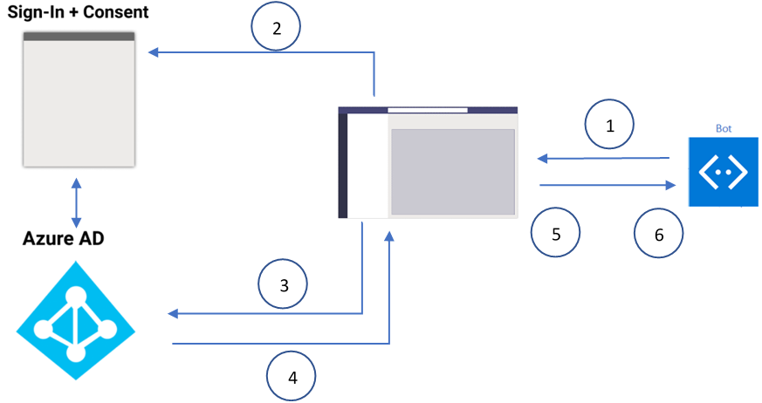
了解机器人的 SSO 身份验证流
机器人请求为机器人应用提供认证令牌。 用户在所有活动用户端点接收消息。
如果当前用户是第一次使用你的机器人应用，就会显示请求提示，要求用户同意或处理升级认证。
Microsoft Teams 从 Azure AD 终结点为当前用户请求机器人应用令牌。
Azure AD 将机器人应用令牌发送到 Microsoft Teams 应用。
Microsoft Teams 将令牌作为 invoke 活动返回的值对象的一部分发送给机器人，名称为 sign-in/tokenExchange。
机器人应用中的解析令牌提供所需的信息，例如用户的电子邮件地址。
Notes:
Let's look at how the SSO process works at runtime in bots. The flow is similar to that of Microsoft Teams tab SSO support, however, the difference is in the protocol for how a bot requests tokens and receives responses.
Note for step #1:
A user can have more than one active endpoint at a time.
The bot token is received from every active user endpoint.
The app must be installed in personal scope for SSO support.

Slide 52
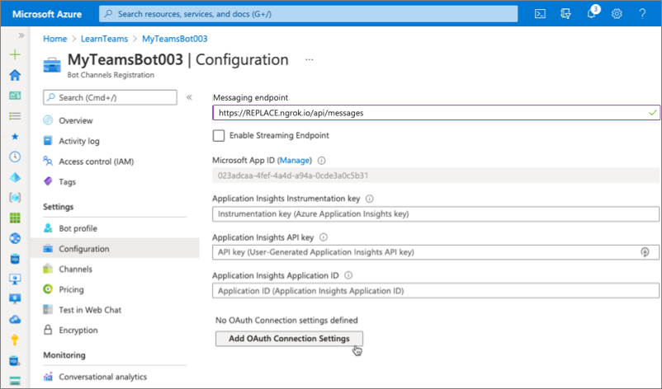
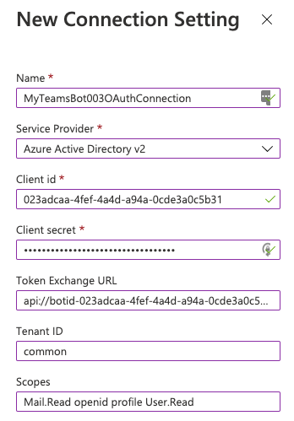
为机器人配置适用于 SSO 的 Azure AD 应用
与选项卡的客户端性质相比，机器人有一些独特的特点，因为它们有基于服务器的互动体验。
应用的 Redirect URI 应指向 Azure Bot Framework 的令牌端点：https://token.botframework.com/.auth/Web/redirect
公开 API 权限 access_as_user 时，应用 ID URI 应包括字符串 botid-，而不是托管机器人服务的域：
api://botid-023adcaa-4fef-4a4d-a94a-0cde3a0c5b31
在 Azure Bot Framework 中配置机器人的 Oauth 连接设置
与选项卡的客户端性质相比，机器人有一些独特的特点，因为它们有基于服务器的互动体验。
应用的Redirect URI 应指向 Azure Bot Framework 的令牌端点：https://token.botframework.com/.auth/Web/redirect
公开 API 权限 access_as_user 时，应用 ID URI 应包括字符串 botid-，而不是托管机器人服务的域：
api://botid-023adcaa-4fef-4a4d-a94a-0cde3a0c5b31
在 Azure Bot Framework 中配置机器人的 Oauth 连接设置
Notes:
All Microsoft Teams app that implement SSO must also have an associated Azure AD app registered. The Azure AD app used for bot SSO shares many characteristics when used for tab SSO. For example, all Azure AD apps used with Microsoft Teams SSO must have the following:
client ID & client certificate/secret: these are used by your app to authenticate with Azure AD
permissions: this is a list of the API permissions your app needs the user to consent to, such as User.Read or Mail.Read
obtain tokens with the OAuth2 implicit flow: Microsoft Teams must be able to obtain the access tokens and ID tokens
access_as_user permission: this permission exposed by the app registration is used to grant apps, such as Microsoft Teams, to act on the user's behalf
preauthorize Microsoft Teams clients to act on the user's behalf: this setting removes the requirement for users to explicitly consenting to allow Microsoft Teams to act on the user's behalf
For a bot to support SSO, you must update it's OAuth connection settings. This process associates the bots with the authentication provider (Azure AD), the Azure AD application associated with the bot, the application's ID URI and the permissions the bot needs to obtain an access token for. This is done within the bot's settings screen in the Azure Bot Framework.
Bots registered with the Azure Bot Framework can be used with Microsoft Teams
To support SSO, add an OAuth connection setting in the bot’s properties
Associate the bot OAuth settings with the registered Azure AD app
Set the Token Exchange URL to the Application ID URI
Set Tenant ID to common
Set Scopes to a space-delimited list of permissions the bot needs

Slide 53
将 Azure AD 应用与 Microsoft Teams 应用关联
首先，你必须将 Azure AD 应用与 Microsoft Teams 应用关联。
JSON
"webApplicationInfo": { "id": "023adcaa-4fef-4a4d-a94a-0cde3a0c5b31", "resource": "api://botid-023adcaa-4fef-4a4d-a94a-0cde3a0c5b31" }
ID：这是注册的 Azure AD 应用的客户 ID
资源：这是应用的 URL，与在 Azure AD 中注册应用时使用的 URI 相同。
Notes:
To implement SSO in your bot, you must first associate the Azure AD app with the Microsoft Teams app. This is done in the app's manifest.json file in the webApplicationInfo object:
"webApplicationInfo": { "id": "023adcaa-4fef-4a4d-a94a-0cde3a0c5b31", "resource": "api://botid-023adcaa-4fef-4a4d-a94a-0cde3a0c5b31" }
There are two parts of this section that must be updated for your application:
ID: This is the client ID of the registered Azure AD application
Resource: This is the URL of the app, which is the same thing as the URI that was used when registering the app in Azure AD.

Slide 54
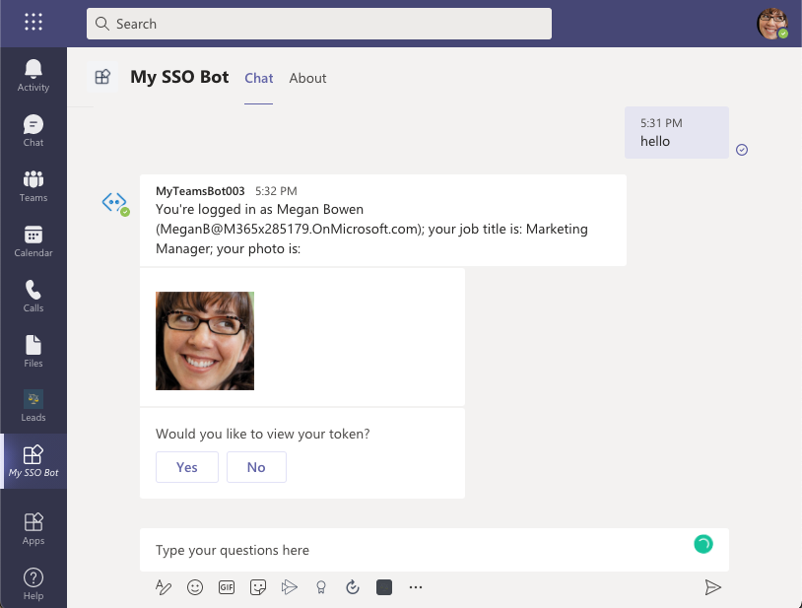
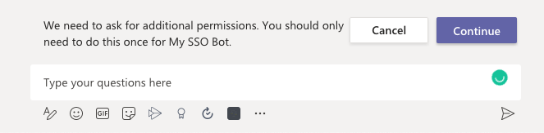
Microsoft Teams SSO 机器人终端用户体验
当用户第一次激活机器人时，系统会提示同意
当用户选择“继续”时，会发生以下事件：
如果机器人定义了一个登录按钮，机器人的登录流程就会被触发，类似于消息流中 OAuth 卡按钮的登录流程。开发人员必须决定哪些权限需要用户的同意。
如果机器人未在 OAuth 卡上提供登录按钮， 则需要用户同意才能获得最小权限集合。
在构建需要经过身份验证的用户的机器人时， 请考虑使用对话。
Notes:
The request to get access token involves submitting an HTTP POST message request using the existing message schema. Its included in the attachments of an OAuthCard. The schema for the OAuthCard class is defined in Microsoft Bot Schema 4.0 and its similar to a sign-in card.
Microsoft Teams treats the request as a silent token acquisition if the TokenExchangeResource property is populated on the card. For Microsoft Teams channels, only the ID property, which uniquely identifies a token request, is honored.
When the user sends a message to the bot for the first time, they must first consent to the application. Microsoft Teams displays this consent experience above the message box:
When the user selects Continue, the following events occur:
If the bot defines a sign-in button, the sign-in flow for bots is triggered similar to the sign-in flow from an OAuth card button in a message stream. The developer must decide which permissions require user's consent.
This approach is recommended if you require a token with permissions beyond openid such as in the case when you want to exchange the token for Microsoft Graph resources.
If the bot isn't providing a sign-in button on the OAuth card, user consent is required for a minimal set of permissions. This token is useful for basic authentication to identify the user. For example, to get the user's email address, identity provider's object ID, the user's tenant ID, or the user's display name.
When building a bot that that requires an authenticated user, consider using dialogs. Dialogs provide a state-based model to manage a long-running conversation with the user. The nature of the sequential conversation that depends on authentication makes dialogs well suited for this scenario.
Dialogs simplify the sequential steps of signing in, interacting with the user and secured resources requiring user and bot authorization, and ultimately signing out. Learn more from the Bot Framework documentation: Dialogs and Bot Framework SDK: Dialogs library.

Slide 55
为 Microsoft Teams 编码 SSO 机器人
瀑布式对话的第一步提示用户和机器人进行身份验证
接下来，登录步骤将尝试使用机器人的身份验证支持获取访问令牌。
如果成功，则使用在 OAuth 流程中获得的访问令牌，向 Microsoft Graph 提交请求，以显示从 Microsoft Graph 返回的信息。
TypeScript
this.addDialog(new WaterfallDialog(MAIN_WATERFALL_DIALOG, [
this.promptStep.bind(this),
this.displayMicrosoftGraphDataStep.bind(this)
]));
TypeScript
public async promptStep(stepContext: WaterfallStepContext): Promise<DialogTurnResult> {
try {
return await stepContext.beginDialog(OAUTH_PROMPT_ID);
}
catch (err) {
console.error(err);
}
return await stepContext.endDialog();
}
Notes:
The following example demonstrates using a waterfall dialog
this.addDialog(new WaterfallDialog(MAIN_WATERFALL_DIALOG, [ this.promptStep.bind(this), this.displayMicrosoftGraphDataStep.bind(this) ]));
This first step in the waterfall dialog prompts the user and bot to authenticate:
public async promptStep(stepContext: WaterfallStepContext): Promise<DialogTurnResult> { try { return await stepContext.beginDialog(OAUTH_PROMPT_ID); } catch (err) { console.error(err); } return await stepContext.endDialog(); }
Next, the login step will attempt to obtain an access token using the bot's authentication support. If successful, it uses the access token obtained in the OAuth process to submit a request to Microsoft Graph to display information returned from Microsoft Graph:
public async displayMicrosoftGraphDataStep(stepContext: WaterfallStepContext): Promise<DialogTurnResult> { // get token from prev step (or directly from the prompt itself) const tokenResponse = stepContext.result; if (!tokenResponse?.token) { await stepContext.context.sendActivity("Login not successful, please try again."); } else { const msGraphClient = new MsGraphHelper(tokenResponse?.token); const user = await msGraphClient.getCurrentUser(); await stepContext.context.sendActivity(`Thank you for signing in ${user.displayName as string} (${user.userPrincipalName as string})!`); await stepContext.context.sendActivity(`I can retrieve your details from Microsoft Graph using my support for SSO! For example...`); const email = await msGraphClient.getMostRecentEmail(); await stepContext.context.sendActivity(`Your most recent email about "${email.subject as string}" was received at ${new Date(email.receivedDateTime as string).toLocaleString()}.`); } return await stepContext.endDialog(); }
When you run the bot, the first time the user interacts with the bot, they'll be prompted to consent to a sign-in experience:
Once they consent by selecting the Continue button, the bot will display information about the currently signed in user.
This information was retrieved using the SSO support in Microsoft Teams to obtain an ID token for the currently signed in user, exchanging this ID token for an access token, and using that to submit requests to Microsoft Graph:
Finally, when the user submits the message logout, it will complete the sign-out process:

Slide 56
为 Microsoft Teams 编码 SSO 机器人
接下来，登录步骤将尝试使用机器人的身份验证支持获取访问令牌。 如果成功，则使用在 OAuth 流程中获得的访问令牌，向 Microsoft Graph 提交请求，以显示从 Microsoft Graph 返回的信息：
TypeScript
public async displayMicrosoftGraphDataStep(stepContext: WaterfallStepContext): Promise<DialogTurnResult> {
// get token from prev step (or directly from the prompt itself)
const tokenResponse = stepContext.result;
if (!tokenResponse?.token) {
await stepContext.context.sendActivity("Login not successful, please try again.");
} else {
const msGraphClient = new MsGraphHelper(tokenResponse?.token);
const user = await msGraphClient.getCurrentUser();
await stepContext.context.sendActivity(`Thank you for signing in ${user.displayName as string} (${user.userPrincipalName as string})!`);
await stepContext.context.sendActivity(`I can retrieve your details from Microsoft Graph using my support for SSO! For example...`);
const email = await msGraphClient.getMostRecentEmail();
await stepContext.context.sendActivity(`Your most recent email about "${email.subject as string}" was received at ${new Date(email.receivedDateTime as string).toLocaleString()}.`);
}
return await stepContext.endDialog();
}

Slide 57
谢谢！

